Slide 1
Decoding Satisfaction
What actually drives mobile phone ratings?
Shanay Murdock
WGU Data Science Graduate Student, D606 Capstone

Slide 2

Presenter Profile
Shanay Murdock
Data Science Graduate Student | WGU
Business Systems Analyst | Florida State University
Tech + Anthropology background: Focused on the human-driven “whys” behind the numbers

Slide 3
Today’s Roadmap
The business problem & guiding hypothesis
Data and analysis process
Key findings: What matters to customers
Limitations and caveats
Strategic actions
Expected benefits

Slide 4
The Big Question
Challenge: Where do we invest for maximum customer satisfaction?
Gut instinct? Branding? Price? Features?
Hypothesis:
  Can a statistical model predict overall customer satisfaction with an accuracy of 70% or better?

Slide 5
Data & Analysis Overview
50,000 global customer reviews, 8 countries
Looked at brand, price, and main technological features (camera, battery, design, etc.)
Used a step-by-step “decluttering” process:
  Start with all variables
  Remove what doesn’t influence satisfaction
  Keep only true predictors of customer satisfaction
All Features → Eliminate Non-Predictors → Key Drivers Remain

Slide 6
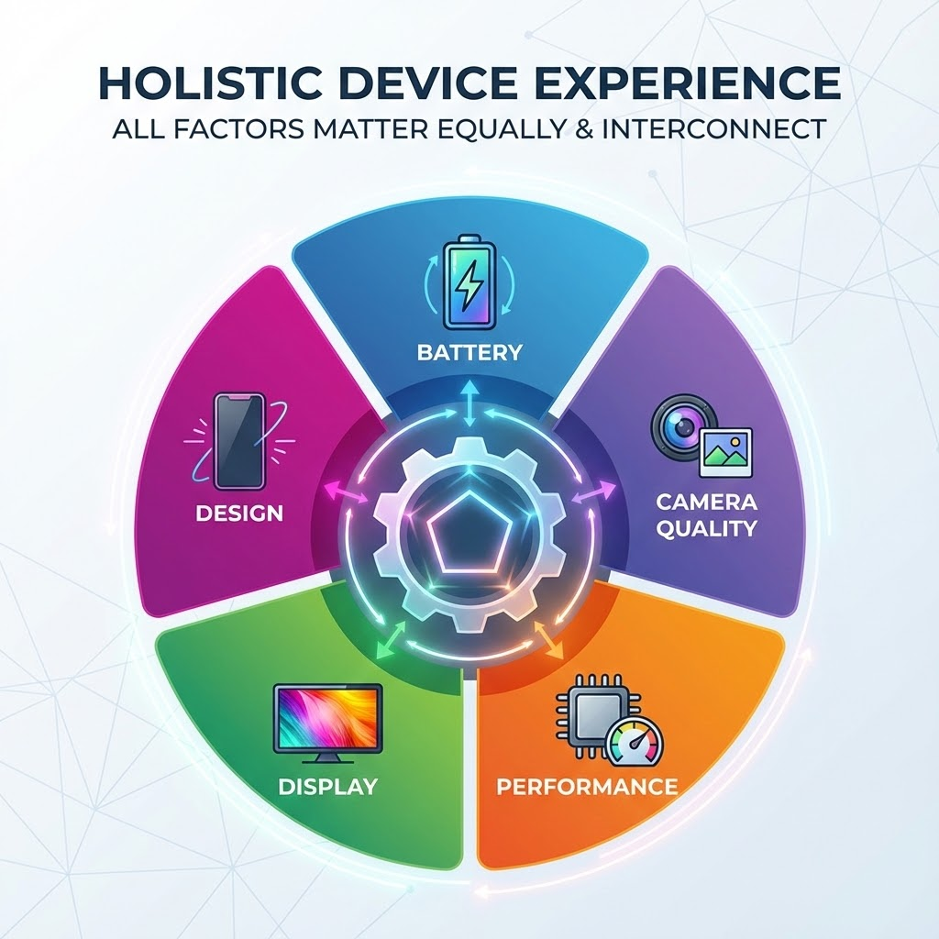
Key Findings: The Five Pillars of Satisfaction
Only 5 features truly matter for high ratings:
Battery Life
Camera Quality
Performance (Speed, smoothness)
Design
Display
Weakness in any one lowers overall customer satisfaction

Slide 7
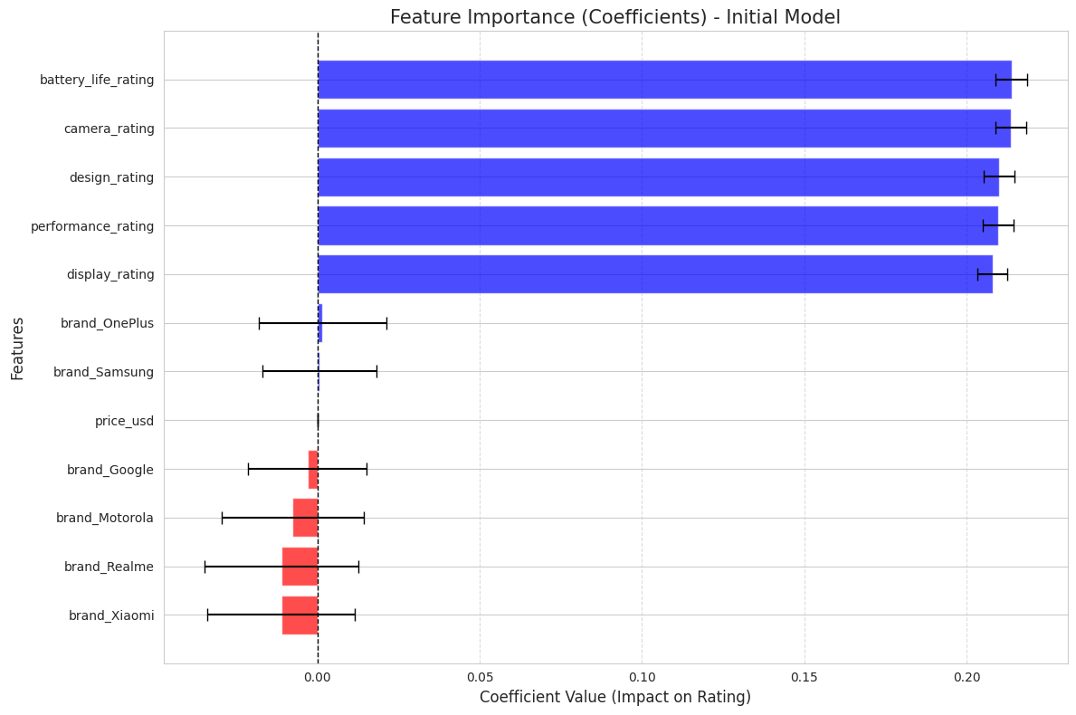
Brand & Price: Surprising Results
Brand name and price have little effect on customer satisfaction after accounting for the five key features.
High ratings are earned by performance – not prestige or price tag.
Even budget brands can achieve 5 stars by by delivering on the essential performance drivers.

Slide 8
86.6% accuracy
How Strong Is This Model?
Model predicts satisfaction with 86.6% accuracy
Meets and exceeds the original 70% goal
Reliable focus for our R&D Investment

Slide 9
Limitations & Considerations
Most top phones excel in all five areas – features tend to “move together”
Hard to pinpoint a single “target” feature
Known in statistics as “multicollinearity”

Slide 10
Recommended Actions
Balanced, Don’t Specialize: Invest evenly in all five pillars – don’t gamble everything on just one feature
Focus Messaging: Our marketing should spotlight tangible hardware strengths, not just brand identity.
Budget Devices Matter: High satisfaction isn’t reserved from premium models; even our budget phones deserve attention on all five pillars

Slide 11
Expected Benefits: Projected Business Impact
R&D resources focused on features customers truly value
Millions in reduced waste by cutting non-essential feature costs
Increase our chances of 5-star ratings
Protect and grow our place in a fiercely competitive market

Slide 12
References
Kaggle. (2025, October 22). Retrieved November 1, 2025, from https://www.kaggle.com/datasets/mohankrishnathalla/mobile-reviews-sentiment-and-specification/data

Slide 13
Q&A
Thank you for joining me today!
I’m happy to clarify findings or discuss next steps

